Slide 1
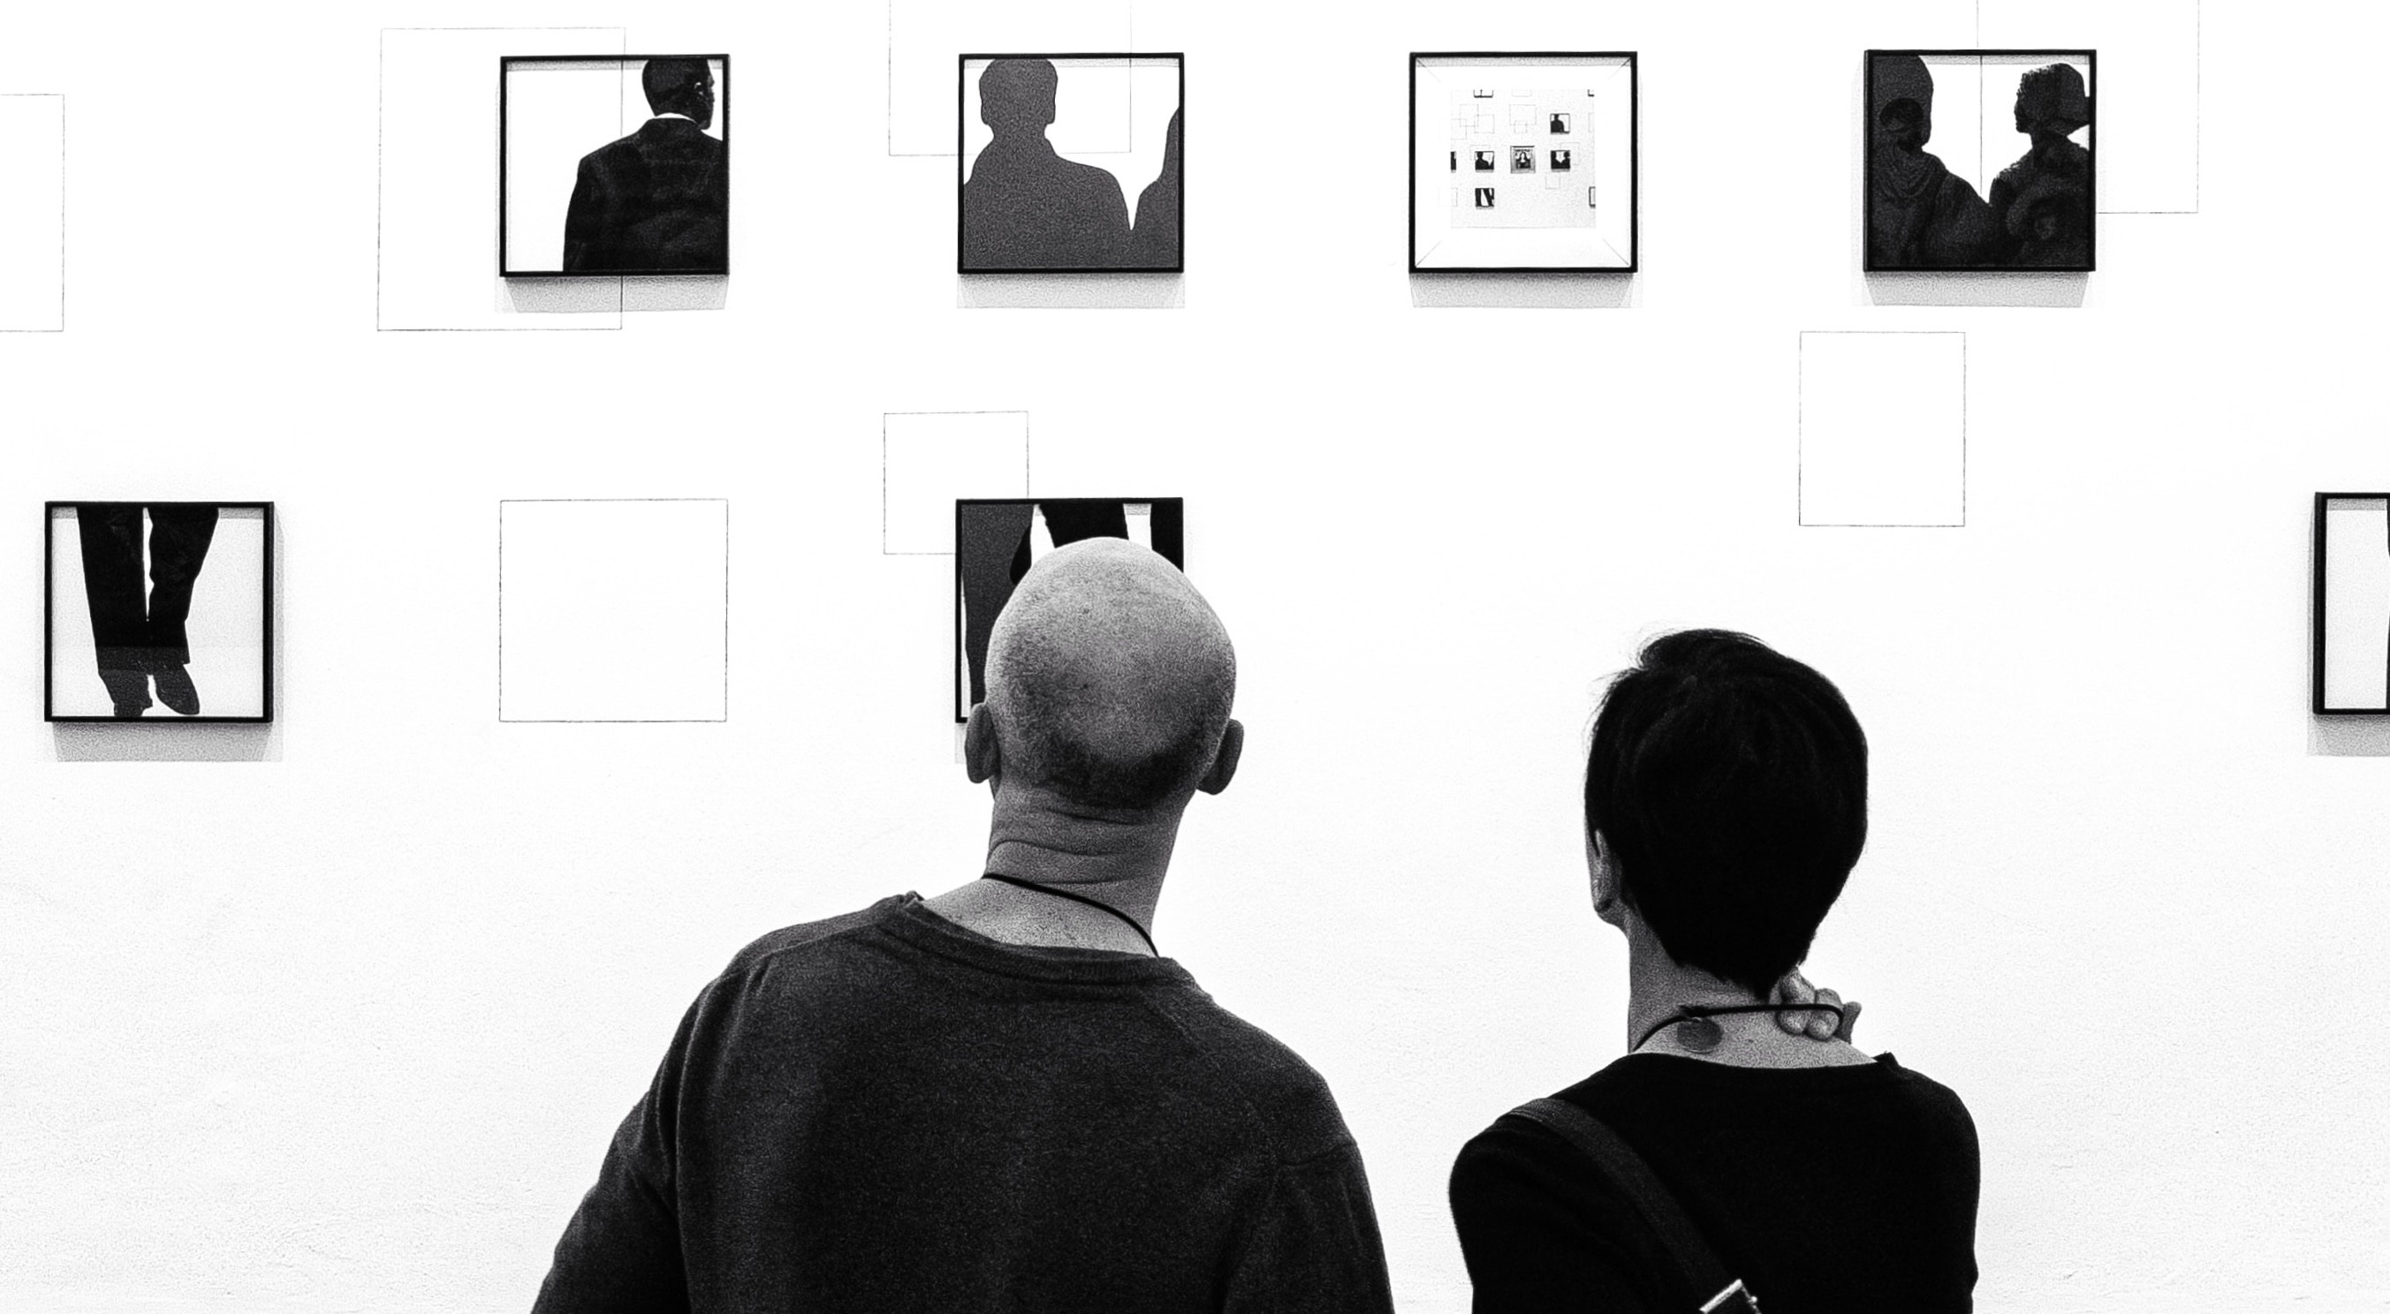
Observer and Observer State Feedback
Linear Systems
Observers and Observer State FB

Slide 2
Introduction
▶ full state feedback is usually not available
▶ the state estimation problem
▶ deterministic case: observer design
▶ stochastic case: the most frequent option is Kalman filter
Observers and Observer State FB
2 / 27

Slide 3
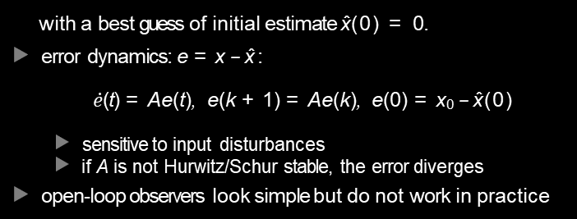
Open-loop observer
d dt
x (t) = Ax (t) + Bu(t), x (k + 1) = Ax (k) + Bu(k)
▶ conceptually simplest scheme to estimate x :
d dt
xˆ(t) = Axˆ(t) + Bu(t), xˆ(k + 1) = Axˆ(k) + Bu(k)
with a best guess of initial estimate xˆ(0) = 0.
▶ error dynamics: e = x − xˆ:
$\dot{e}$(t) = Ae(t), e(k + 1) = Ae(k), e(0) = x₀ − xˆ(0)
▶ sensitive to input disturbances
▶ if A is not Hurwitz/Schur stable, the error diverges
▶ open-loop observers look simple but do not work in practice
e.g.
Observers and Observer State FB
3 / 27

Slide 4
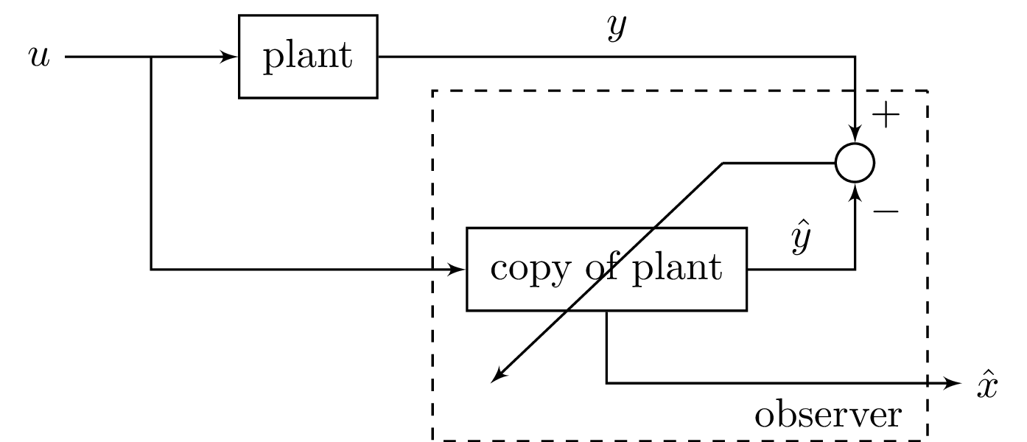

Luenberger (closed-loop) observer concept
▶ given system dynamics
$\dot{x}$ = Ax + Bu, x (0) = x₀, A ∈ R^{n×n}, B ∈ R^{n×r}
y = Cx, y ∈ R^{m×n}
▶ in contrast to open-loop observers, the Luenberger observer adds correction based on output differences
Observers and Observer State FB
4 / 27

Slide 5

Luenberger (closed-loop) observer algorithm
observer concept
plant:
$\dot{x}$= Ax + Bu, x (0) = x₀ y = Cx
▶ observer realization:
$\dot{\hat{x}}$= Axˆ + Bu + L (y − yˆ) = Axˆ + Bu + L (y − C xˆ) , xˆ(0) = 0
= (A − LC ) xˆ + Ly + Bu
Observers and Observer State FB
5 / 27

Slide 6

Luenberger (closed-loop) observer error dynamics
▶ system dynamics
$\dot{x}$= Ax + Bu, x (0) = x₀, A ∈ R^{n×n}, B ∈ R^{n×r}
y = Cx, y ∈ R^{m×n}
▶ Luenberger observer with correction:
$\dot{\hat{x}}$= Axˆ + Bu + L (y − yˆ) = Axˆ + Bu + L (y − C xˆ) , xˆ(0) = 0
= (A − LC ) xˆ + Ly + Bu
▶ error dynamics: e = x − xˆ:
$\dot{e}$= Ae − LCe = (A − LC )e, e(0) = x (0)
▶ if all eigenvalues of A − LC are on the left half plane, then the error dynamics can be made asymptotically stable
Observers and Observer State FB
6 / 27

Slide 7

Luenberger (closed-loop) observer
Theorem
If (A, C ) is an observable pair, then all the eigenvalues of A − LC can be arbitrarily assigned, provided that they are symmetric with respct to the real axis of the complex plane.
▶ we show the SISO case when A and C are in observable canonical form (if not, a similarity transform can help out):
$$A=\left[\begin{matrix}−α_{n−1} & 1 & 0 & ⋯ \\ ⋮ & 0 & ⋱ & ⋱ \\ −α_{1} & ⋮ & ⋱ & 1 \\ −α_{0} & 0 & ⋯ & 0\end{matrix}\right], B=\left[\begin{matrix}β_{n−1} \\ ⋮ \\ β_{1} \\ β_{0}\end{matrix}\right]$$
$$C=\left[\begin{matrix}1 & 0 & ⋯ & 0\end{matrix}\right], D=d$$
$$\det\left(sI−A\right)=s^{n}+α_{n−1}s^{n−1}+⋯+α_{1}s+α_{0}$$
Observers and Observer State FB
7 / 27

Slide 8

Observer eigenvalue placement: o.c.f.
▶ Luenberger observer with correction:
$\dot{\hat{x}}$= Axˆ + Bu + L (y − yˆ) = Axˆ + Bu + L (y − C xˆ) , xˆ(0) = 0
= (A − LC ) xˆ + Ly + Bu
▶ Goal: place eigenvalues of the observer at locations ${\overline{p}}_{1}, ⋯, {\overline{p}}_{n}$:
$$\det\left(sI−\left(A−LC\right)\right)=\left(s−{\overline{p}}_{1}\right)\left(s−{\overline{p}}_{2}\right)⋯\left(s−{\overline{p}}_{n}\right)$$
$$=s^{n}+{\overline{γ}}_{n−1}s^{n−1}+⋯+{\overline{γ}}_{1}s+{\overline{γ}}_{0}$$
Observers and Observer State FB
8 / 27

Slide 9


Observer eigenvalue placement: o.c.f.
▶ Goal: place eigenvalues of the observer at locations ${\overline{p}}_{1}, ⋯, {\overline{p}}_{n}$:
$$\det\left(sI−\left(A−LC\right)\right)=\left(s−{\overline{p}}_{1}\right)\left(s−{\overline{p}}_{2}\right)⋯\left(s−{\overline{p}}_{n}\right)$$
$$=s^{n}+{\overline{γ}}_{n−1}s^{n−1}+⋯+{\overline{γ}}_{1}s+{\overline{γ}}_{0}$$
▶ Let L = [l₀, l₁, . . . , l_{n−1}]^{T} . The unique structures of A and C give
$LC=\left[\begin{matrix}I_{0} \\ ⋮ \\ I_{n−2} \\ I_{n−1}\end{matrix}\right]\left[\begin{matrix}1 & 0 & ⋯ & 0\end{matrix}\right]=$ $\left[\begin{matrix}I_{0} & 0 & ⋯ & 0 \\ ⋮ & 0 & ⋱ & ⋮ \\ I_{n−2} & ⋱ & ⋱ & 0 \\ I_{n−1} & 0 & ⋯ & 0\end{matrix}\right]$
$A−LC=$ $\left[\begin{matrix}−α_{n−1}−I_{0} & 1 & 0 & ⋯ & 0 \\ −α_{n−2}−I_{1} & 0 & ⋱ & ⋱ & ⋮ \\ ⋮ & 0 & ⋱ & ⋱ & 0 \\ −α_{1}−I_{n−2} & ⋮ & ⋱ & 0 & 1 \\ −α_{0}−I_{n−1} & 0 & ⋯ & 0 & 0\end{matrix}\right]$
Observers and Observer State FB
9 / 27

Slide 10



Observer eigenvalue placement: o.c.f.
▶ A and A − LC have the same structure:
$$A=\left[\begin{matrix}−α_{n−1} & 1 & 0 & ⋯ \\ ⋮ & 0 & ⋱ & ⋱ \\ −α_{1} & ⋮ & ⋱ & 1 \\ −α_{0} & 0 & ⋯ & 0\end{matrix}\right], A−LC= \left[\begin{matrix}−α_{n−1}−I_{0} & 1 & 0 & ⋯ & 0 \\ −α_{n−2}−I_{1} & 0 & ⋱ & ⋱ & ⋮ \\ ⋮ & 0 & ⋱ & ⋱ & 0 \\ −α_{1}−I_{n−2} & ⋮ & ⋱ & 0 & 1 \\ −α_{0}−I_{n−1} & 0 & ⋯ & 0 & 0\end{matrix}\right]$$
▶ Recall: det (sI − A) = s^{n} + α_{n−1}s^{n−1} +$⋯$ + α₁s + α₀.
▶ Thus
$$\det\left(sI−\left(A−LC\right)\right)=s^{n}+\underset{target: {\overline{γ}}_{n−1}}{\underbrace{\left(α_{n−1}+I_{0}\right)}}s^{n−1}+⋯+\underset{target: {\overline{γ}}_{0}}{\underbrace{\left(α_{0}+I_{n−1}\right)}}$$
▶ Hence
$$I_{0}={\overline{γ}}_{n−1}−α_{n−1}$$
$$⋮$$
$$I_{n−1}={\overline{γ}}_{0}−α_{0}$$
Observers and Observer State FB
10 / 27

Slide 11



General observer eigenvalue placement
▶ What if (A, B, C, D) is not in the observable canonical form?
▶ We can transform it to o.c.f. via a similarity transform:
$$\left\{\begin{aligned}\dot{x}=Ax+Bu \\ y=Cx\end{aligned} \underset{⇒}{x=R^{−1}x_{ob}} \right.\left\{\begin{aligned}{\dot{x}}_{ob}=\underset{A_{0}}{\underbrace{RAR^{−1}}}x_{ob}+\underset{B_{0}}{\underbrace{RB}}u \\ y=C_{0}x_{ob}=CR^{−1}x_{ob}\end{aligned}\right.$$
▶ use previous formulas to design L˜ in:
${\dot{\hat{x}}}_{ob}$=(A_{o} − L˜C_{o} ) xˆ_{ob} + L˜y + B_{o}u (analysis form)
▶ correspondingly in the original state space (via xˆ_{ob} = Rxˆ):
R$\dot{\hat{x}}$= (RAR⁻¹ − L˜CR⁻¹)Rxˆ + L˜y + RBu
$$⇒\dot{\hat{x}}=(A−\overset{L}{\overbrace{R^{−1}\tilde{L}}}C)\hat{x}+Ly+Bu$$
(implementation form)
Observers and Observer State FB
11 / 27

Slide 12
General observer eigenvalue placement
▶ Powerful fact: if system Σ = (A, B, C, D) is observable, then we can arbitrarily place the observer eigenvalues.
Observers and Observer State FB

Slide 13
Observer design in MATLAB and Python
%MATLAB | #Python
A = [0 1;-4 -0.2]; B = [0 1]’; | import control as ct
C = [1 0]; | import numpy as np
sys = ss(A,B,C,0); | A = np.array([[0, 1],[-4, -0.2]])
eig(A) | C = np.array([[1], [0]]).T
L = place(A’,C’,[-2,-3])’ | L = ct.place(A.T,C.T,[-2, -3]).T
eig(A-L*C) | print(L)
Observers and Observer State FB

Slide 14
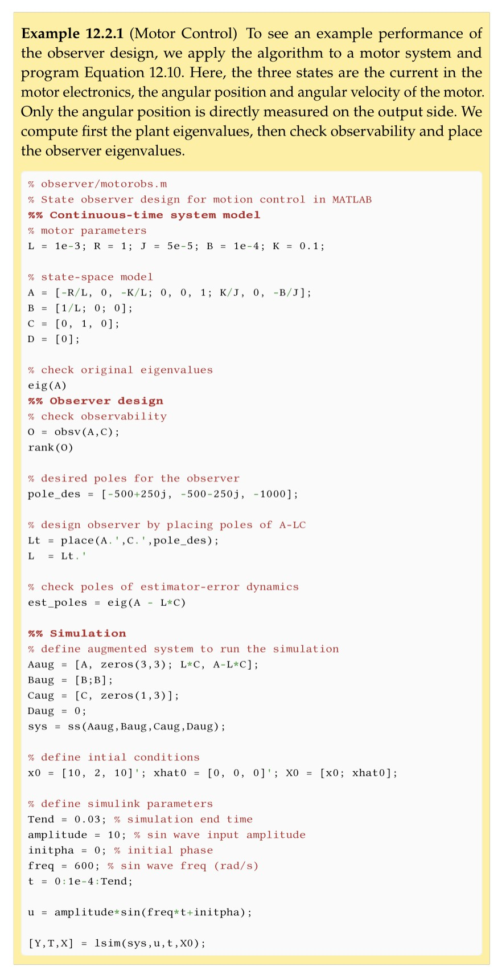
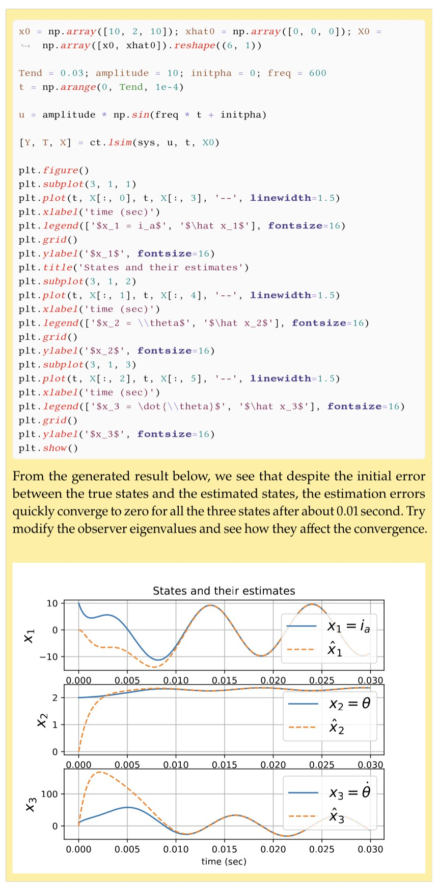

Motor control example
Observers and Observer State FB

Slide 15
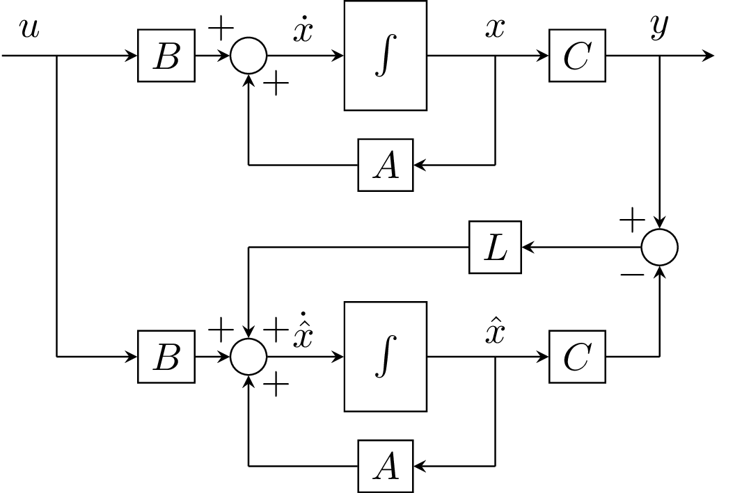

Luenberger observer summary
▶ observer dynamics: $\dot{\hat{x}}$= Axˆ + Bu + L (y − C xˆ) , xˆ(0) = 0
▶ block diagram
Observers and Observer State FB

Slide 16


Luenberger observer summary
▶ system dynamics
$\dot{x}$ = Ax + Bu, x (0) = x₀, A ∈ R^{n×n}, B ∈ R^{n×r}
y = Cx, y ∈ R^{m×1}
▶ observer dynamics
$\dot{\hat{x}}$= Axˆ + Bu + L (y − C xˆ) , xˆ(0) = 0
= (A − LC ) xˆ + LCx + Bu
▶ augmented system
$$\left[\begin{matrix}\dot{x} \\ \dot{\hat{x}}\end{matrix}\right]=\left[\begin{matrix}A & 0 \\ LC & A−LC\end{matrix}\right]\left[\begin{matrix}x \\ \hat{x}\end{matrix}\right]+\left[\begin{matrix}B \\ B\end{matrix}\right]u$$
Observers and Observer State FB
16 / 27

Slide 17




Luenberger observer summary
▶ augmented system
$$\left[\begin{matrix}\dot{x} \\ \dot{\hat{x}}\end{matrix}\right]=\left[\begin{matrix}A & 0 \\ LC & A−LC\end{matrix}\right]\left[\begin{matrix}x \\ \hat{x}\end{matrix}\right]+\left[\begin{matrix}B \\ B\end{matrix}\right]u$$
y = Cx
▶ to see the distribution of eigenvalues, note the error dynamics
$\dot{e}$ = (A − LC )e ⇒
$$\left[\begin{matrix}\dot{x} \\ \dot{e}\end{matrix}\right]=\left[\begin{matrix}A & 0 \\ 0 & A−LC\end{matrix}\right]\left[\begin{matrix}x \\ e\end{matrix}\right]+\left[\begin{matrix}B \\ 0\end{matrix}\right]u$$
⇒eigenvalues are separated into: λ (A) and observer eigenvalues
▶
underlying similarity transform:
$$\left[\begin{matrix}x \\ e\end{matrix}\right]=\left[\begin{matrix}I_{n} & 0 \\ I_{n} & −I_{n}\end{matrix}\right]\left[\begin{matrix}x \\ \hat{x}\end{matrix}\right]$$
Observers and Observer State FB
17 / 27

Slide 18
Discrete-time observers: Introduction
▶ full state feedback is usually not available
▶ often observers are implemented in the discrete-time domain
▶ the discrete-time observer design
▶ basic form: analogous to the continuous-time Luenberger observer
▶ predict and correct form:
▶ direct DT design
▶ leverages discrete-time signal properties
Observers and Observer State FB
18 / 27

Slide 19
Discrete-time full state observer
▶ standard discrete-time observer:
x (k + 1) = Ax (k) + Bu (k)
xˆ(k + 1) = Axˆ(k) + Bu (k) + L (y (k) − C xˆ(k))
y (k) = Cx (k)
▶ error dynamics:e (k) = x (k) − xˆ(k),
e (k + 1) = Ae (k) − LCe (k)
▶ overall dynamics
x (k + 1)
e (k + 1)
A 0
0 A − LC
x (k)
e (k)
B
0
=
+
u (k)
x (k + 1)
e (k + 1)
y (k + 1) = [C, 0]
▶ Powerful fact: the error dynamics can be arbitrarily assigned if the system is observable.
Observers and Observer State FB
19 / 27

Slide 20
DT full state observer with predictor
▶ motivation: xˆ(k + 1) = Axˆ(k) + Bu (k) + L (y (k) − C xˆ(k))
doesn’t use most recent measurement y (k + 1) = Cx (k + 1)
▶ discrete-time observer with predictor:
predictor: xˆ(k + 1|k) = A xˆ(k|k) + Bu (k)
corrector: xˆ(k + 1|k + 1) = xˆ(k + 1|k) + L (y (k + 1) − C xˆ(k + 1|k))
▶ xˆ(k|k): estimate of x (k) based on measurements up to time k
▶ xˆ(k|k − 1): estimate based on measurements up to time k − 1
▶ e(k) ≜ x (k) − xˆ(k|k): estimation error
▶ error dynamics
xˆ(k + 1|k + 1) = (I − LC ) xˆ(k + 1|k) + Ly (k + 1)
= (I − LC ) A xˆ(k|k) + (I − LC ) Bu (k) + Ly (k + 1)
⇒ e (k + 1) = x (k + 1) − Ly (k + 1) − (I − LC )A xˆ(k|k) − (I − LC )Bu(k)
= (A − LCA) e (k)
Observers and Observer State FB
20 / 27

Slide 21


DT full state observer with predictor
$$e\left(k+1\right)=\left(A−L\underset{\tilde{C}}{\underbrace{CA}}\right)e\left(k\right), e\left(0\right)=\left(I−LC\right)x_{0}$$
▶ the error dynamics can be arbitrarily assigned if the pair
(A, C˜)= (A, CA) is observable
▶ observability matrix
$${\tilde{Q}}_{d}=\left[\begin{matrix}\tilde{C} \\ \tilde{C}A \\ ⋮ \\ \tilde{C}A^{n−1}\end{matrix}\right]=\overset{Q_{d}}{\overbrace{\left[\begin{matrix}C \\ CA \\ ⋮ \\ CA^{n−1}\end{matrix}\right]}}A$$
▶ if A is invertible, then Q˜_{d} has the same rank as Q_{d}
▶ (A, C˜)is observable if (A, C ) is observable and A is nonsingular (guaranteed if discretized from a CT system)
Observers and Observer State FB
21 / 27

Slide 22


Example
$$\left[\begin{matrix}x_{1}(k+1) \\ x_{2}(k+1) \\ x_{3}(k+1)\end{matrix}\right]=\left[\begin{matrix}−a_{2} & 1 & 0 \\ −a_{1} & 0 & 1 \\ {−a}_{0} & 0 & 0\end{matrix}\right]\left[\begin{matrix}x_{1}\left(k\right) \\ x_{2}\left(k\right) \\ x_{3}\left(k\right)\end{matrix}\right]+\left[\begin{matrix}b_{2} \\ b_{1} \\ b_{0}\end{matrix}\right]u\left(k\right)$$
y (k) = x₁(k). Place all eigenvalues of an observer with predictor
at the origin.
$$A−LCA=\left[\begin{matrix}−a_{2} & 1 & 0 \\ −a_{1} & 0 & 1 \\ {−a}_{0} & 0 & 0\end{matrix}\right]−\left[\begin{matrix}I_{1} \\ I_{2} \\ I_{3}\end{matrix}\right]\left[\begin{matrix}−a_{2} & 1 & 0\end{matrix}\right]$$
$=$ $\left[\begin{matrix}(I_{1}−1)a_{2} & 1−I_{1} & 0 \\ I_{2}a_{2}−a_{1} & −I_{2} & 1 \\ {I_{3}a_{2}−a}_{0} & −I_{3} & 0\end{matrix}\right]$
det (A − LCA − λI ) = ((l₁ − 1) a₂ − λ) (l₂ + λ) λ +
(1 − l₁) (l₃a_{a} − a₀) + l₃ ((l₁ − 1) a₂ − λ) + λ (1 − l₁) (l₂a₂ − a₁)
roots must be all 0 ⇒l₁ = 1, l₂ = l₃ = 0.
Observers and Observer State FB

Slide 23
1. Concepts
Continuous-time Luenberger observer
Discrete-time observers DT full state observer
DT full state observer with predictor
Observer state feedback
Observers and Observer State FB

Slide 24

Observer state feedback
given system dynamics:
$\dot{x}$ = Ax + Bu y = Cx
▶ state feedback control: arbitrary eigenvalue assignment if system controllable
▶ observer design: arbitrary observer eigenvalue assignment for state estimation if system observable
▶ when full states are not available, what’s the performance if we combine both?
u = −K xˆ + v
Observers and Observer State FB
24 / 27

Slide 25




Closed-loop dynamics
▶ full closed-loop system
$\dot{x}$ = Ax + Bu y = Cx
$\dot{\hat{x}}$ = Axˆ + Bu + L (y − C xˆ)
u = −K xˆ + v
$$\frac{d}{dt}\left[\begin{matrix}x \\ \hat{x}\end{matrix}\right]=\left[\begin{matrix}A & −BK \\ LC & A−LC−BK\end{matrix}\right]\left[\begin{matrix}x \\ \hat{x}\end{matrix}\right]+\left[\begin{matrix}B \\ B\end{matrix}\right]v$$
⇒
▶
$$\left[\begin{matrix}x \\ e\end{matrix}\right]=\left[\begin{matrix}I_{n} & 0 \\ I_{n} & −I_{n}\end{matrix}\right]\left[\begin{matrix}x \\ \hat{x}\end{matrix}\right]$$
using again similarity transform
gives
$$\frac{d}{dt}\left[\begin{matrix}x \\ e\end{matrix}\right]=\left[\begin{matrix}A−BK & BK \\ 0 & A−LC\end{matrix}\right]\left[\begin{matrix}x \\ e\end{matrix}\right]+\left[\begin{matrix}B \\ 0\end{matrix}\right]v$$
Observers and Observer State FB
25 / 27

Slide 26
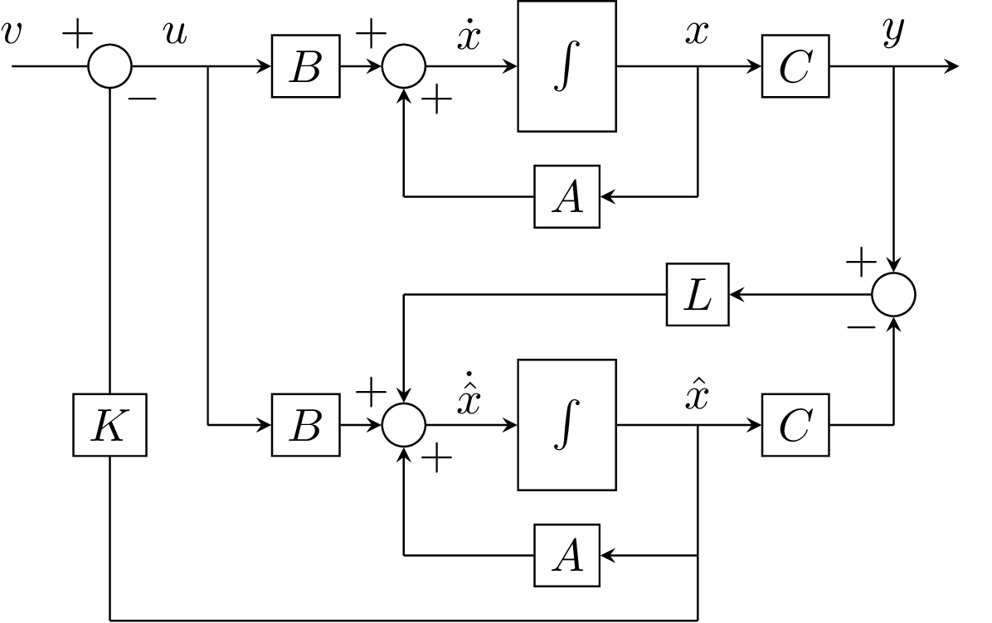

Block diagram
▶ $\dot{\hat{x}}$ = Axˆ + Bu + L (y − C xˆ), u = −K xˆ + v
Observers and Observer State FB

Slide 27

The separation theorem
▶ closed-loop dynamics
$$\frac{d}{dt}\left[\begin{matrix}x \\ e\end{matrix}\right]=\left[\begin{matrix}A−BK & BK \\ 0 & A−LC\end{matrix}\right]\left[\begin{matrix}x \\ e\end{matrix}\right]+\left[\begin{matrix}B \\ 0\end{matrix}\right]v$$
▶ powerful result: separation theorem: closed-loop eigenvalues consist of
▶ eigenvalues of A − BK from the state feedback control design
▶ eigenvalues of A − LC from the observer design
▶ can design K and L separately based on discussed tools
▶ if system is controllable and observable, we can arbitrarily assign the closed-loop eigenvalues
▶ rule of thumb: assign observer dynamics to be faster than state-feedback dynamics
Observers and Observer State FB
27 / 27

